Slide 1

AKTA General Assembly
​​
May 29, 2026

Slide 2
Agenda
Call to order- President Natalie Williams
Welcome and Agenda- Natalie Williams
Introduction of AKTA Board members and Executive Director
Review of 2025 General Assembly minutes-AKTA Secretary Evita Perkins
Treasury report- Kathy Camp AKTA Executive Director
Icebreaker
Introduction of COPSKT Board Members
Council on Professional Standard for Kinesiotherapy Reports
Recognition of Awards- Jameya Barnwell AKTA 2nd Vice President
Introduction of VA Field Advisory Council
VA FAC Updates-Kendall Noble
Installation of New Executive Board Members-Natalie Williams and Kendall Noble
Presidential Address: Kendall Noble AKTA President
Closing Remarks and Adjournment

Slide 3

Meet the AKTA Executive Board
Kathy Camp- Executive Director
Natalie Williams- President
Kendall Noble- President Elect
Jameya Barnwell- 2nd Vice President
Evita Perkins- Secretary
Byron Washington- Treasurer
Sivad Shaw- Member at Large

Slide 4
2025 Minutes Review
AKTA General Assembly Meeting Minutes
​
Minutes of all AKTA meetings are available in the member’s only section of www.AKTA.org

Slide 5

Treasury Report

Slide 6
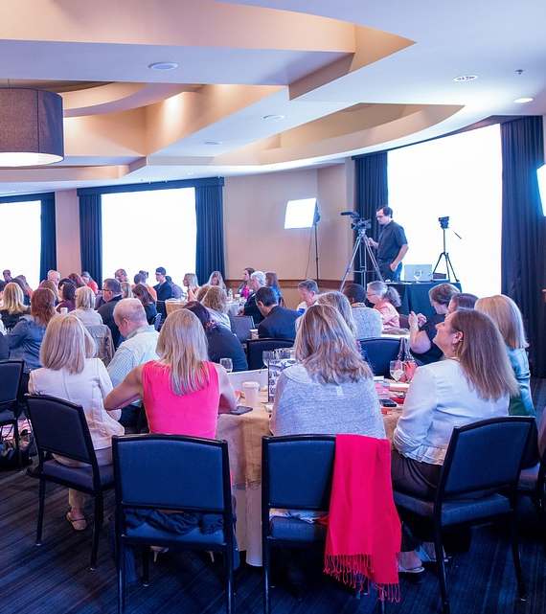
Icebreaker
Novice Therapist (0-9 yrs.)
What is one thing that you are looking forward to in your career?
Seasoned Therapist (10-19 yrs.)
Give 1 thing that you wish you knew earlier about KT or your career.
Expert Therapist (20+ yrs.)
- Give 1 piece of advice to the younger members.

Slide 7
Meet the COPSKT Executive Board
Jerry Purvis, M.S., RKT: Coordinator
Dr. Doris Woods, PhD, RKT: Board of Registration, Director
Bridget Collins, M.S., RKT: Continuing Competency Board, Director
Keshia McMillian, RKT: Continuing Competency Board, Assistant Director
Kim Bloch, RKT: Center of Excellence/KT Equivalency Pathway Board, Director
Jason Teaneck, RKT: Center of Excellence/KT Equivalency Pathway Board, Assistant Director
Lori Shuart, M.S, RKT: General Member (AKTA)
Kareesa Keys, MBA, RKT: Administrative Officer

Slide 8

COPSKT Reports
​

Slide 9

Awards

Slide 10
Presented to an active member who is retired or nearing retirement and has demonstrated exceptional interest and meritorious service to the Association.
Julian Vogel Memorial Life Membership Award
Valerie Perkins

Slide 11
Presidential Citation Award
Orrin Aske

Slide 12
Presidential Citation Award
Lori Lawton

Slide 13

VA FAC Report
​

Slide 14
Meet the VA Field Advisory Council
KT FAC Co-Chairs:
Bryan Garrison (Tampa)
Kendall Noble (Coatesville)
FAC Members:
Joseph Neczek (Hines)
James Nance (Tucson)
Kevin Mejia (Long Beach)
Natalie Williams (Tampa)
Susan Brown (Tampa)
Denise Meadows (Hines)
Arthur Morris (North Chicago)
Lauren Williams (Lake City)
PMRS Program Office Liaison:
Diane Waller (Dallas)

Slide 15

AKTA Executive Board 2027

Slide 16
Officer Nominations
AKTA President-Elect
0 Nominations
AKTA 1st Vice President
Jameya Barnwell
Timothy Morgan
AKTA 2nd Vice President
0 nominations
AKTA Treasurer
Natalie Williams
AKTA Secretary
Susan Brown
AKTA Public Member
0 nominations

Slide 17
Installation of New Officers
President Kendall Noble
Secretary Susan Brown
First Vice President
Second Vice President
Treasurer Natalie Williams

Slide 18

Presidential Address

Slide 19

Call to action
Join an AKTA committee​

Slide 20
Conference Partners
Converge Medical Technology
OrthoCor Medical
Best Priced Products
BodyPoint
Permobil
Pisces Healthcare
Thank you
Conference Speakers
Dr. David Dalbow
Kendall Noble
Evita Perkins
Nona Brown
Regina McWhirter
Marlo O’neill
Andrea Layton
Christina R.Hunter

Slide 21

Announcements​
AKTA Annual Conference 2026 will be held in Dallas, Texas
AKTA Welcome Reception:
Legion Post 88
2717 McCampbell Ave, Nashville, TN 37214
6:30pm

Slide 22

See you in Texas!

